Slide 1
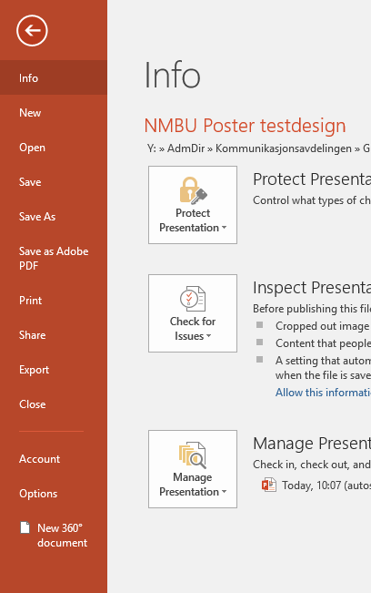
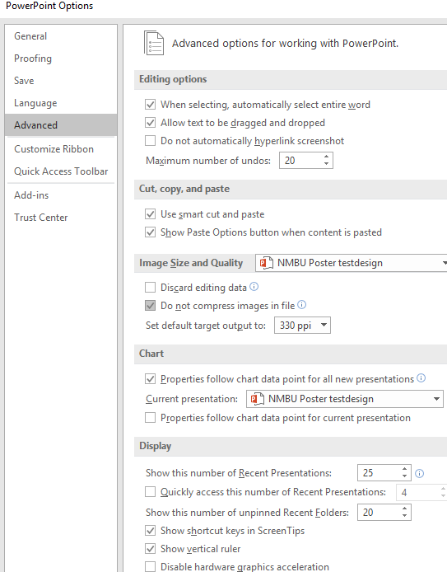
NMBU Poster template
To make sure Powerpoint does not compress images:
Go to File and Options
Select Advanced and Image Size and Quality
Make sure Do not compress images in file is checked

Slide 2
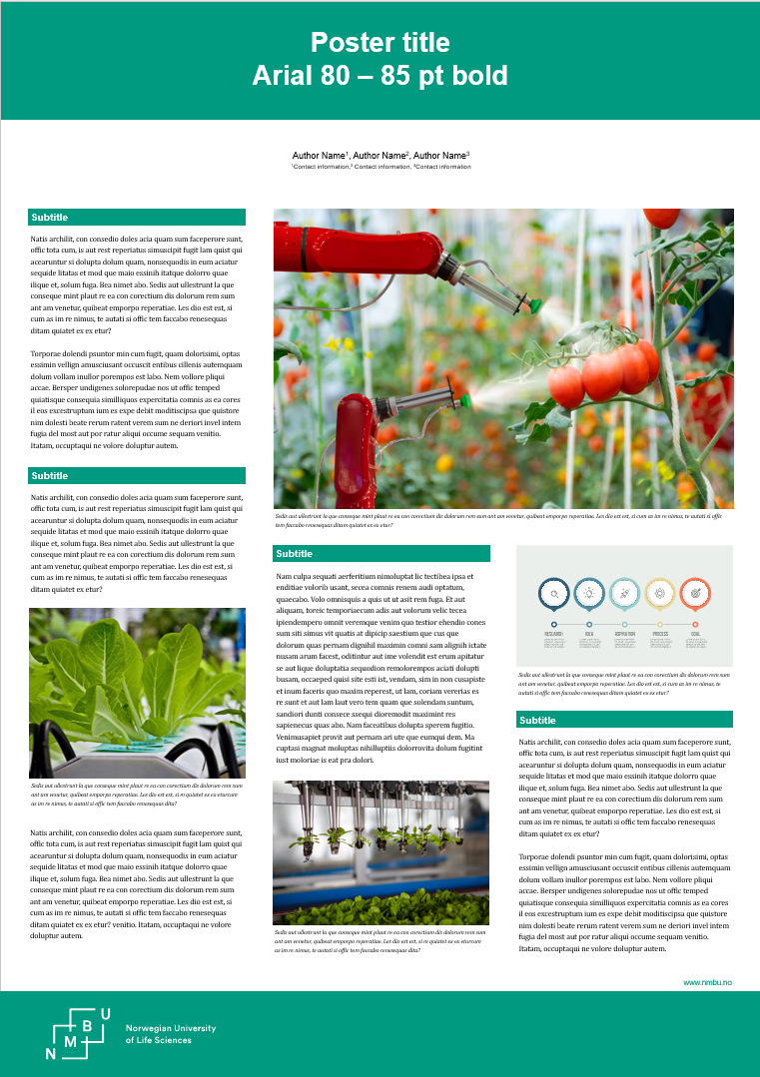
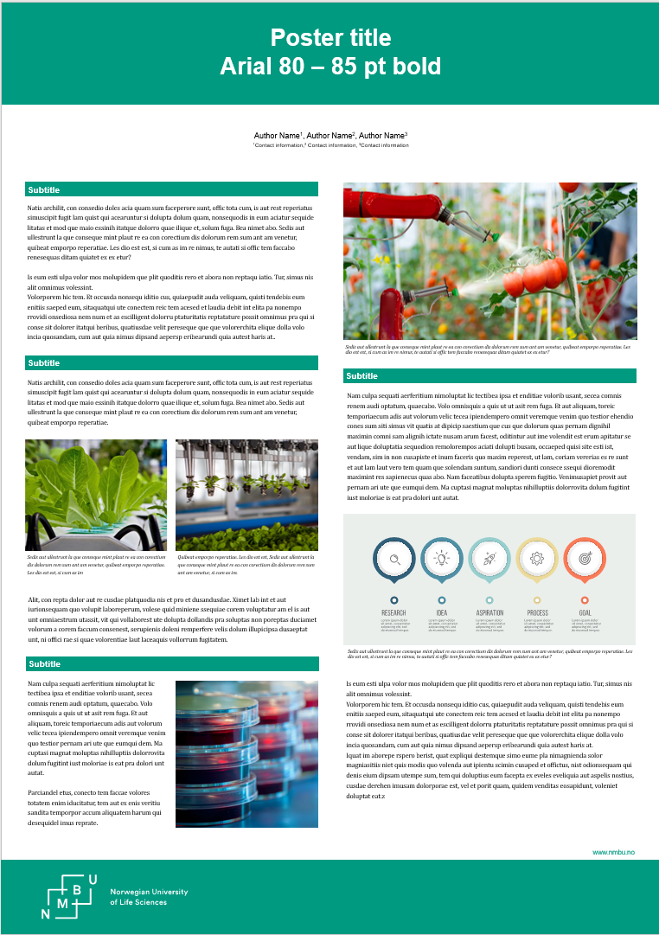
NMBU Poster template
Size: A0 (841 × 1189)mm
Fonts:
Title: Arial bold, 80-85pt
Author Name: Arial regular, 28pt
Author Info: Arial regular, 20pt
Subtitle: Arial bold, 32pt
Body text: Cambria regular, 24pt Line spacing, 36pt
Caption: Cambria italic, 18pt Line spacing, 27pt
Recomended line spacing = font size x 1,5

Slide 3
NMBU Poster, how to
Hide / show guids

Slide 4
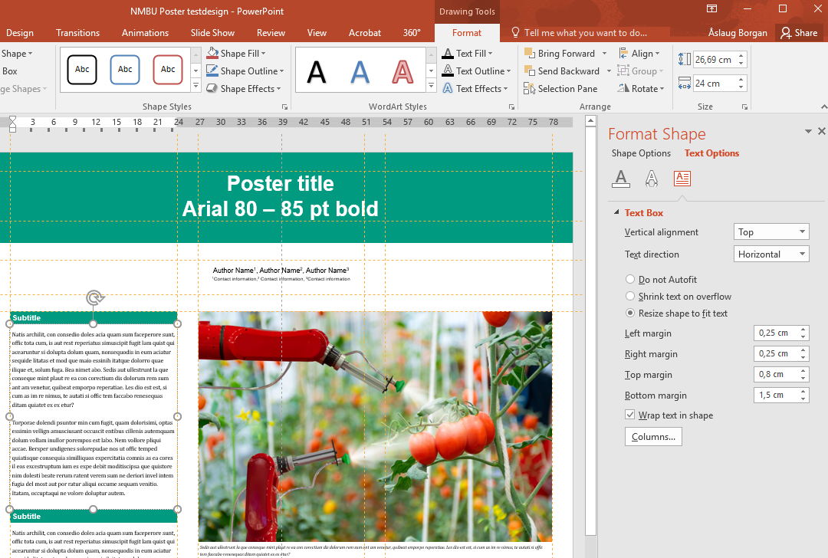
NMBU Poster, how to
Format text box:
Subtitle: all margins 0,25cm
Body text: left margin 0,25cm
right margin 0,25cm
top margin 0,8cm
bottom margin 1,5cm
Caption text: left margin 0,25cm
right margin 0,25cm
top margin 0,3cm
bottom margin 1,5cm

Slide 5
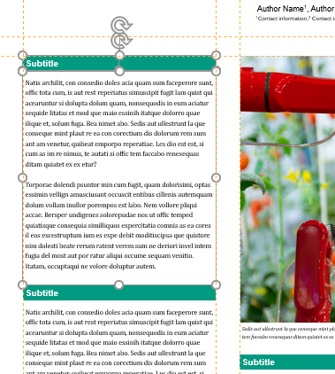
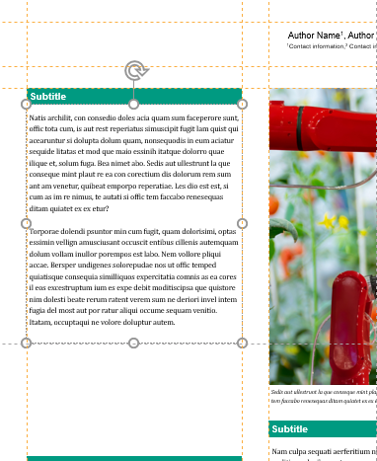
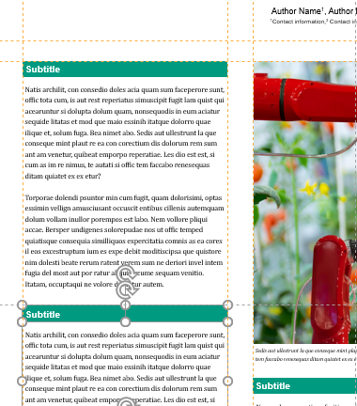
NMBU Poster, how to
Align text box:
With show guids turned on,
Align first Subtitle text box to guide
Align first Body text box to Subtitle
With the Body text box selected, align the dotted black horizontal guide to the bottom of text box
Align the next Subtitle box to the bottom of previous text box
… and so on
1
2
3
4

Slide 6
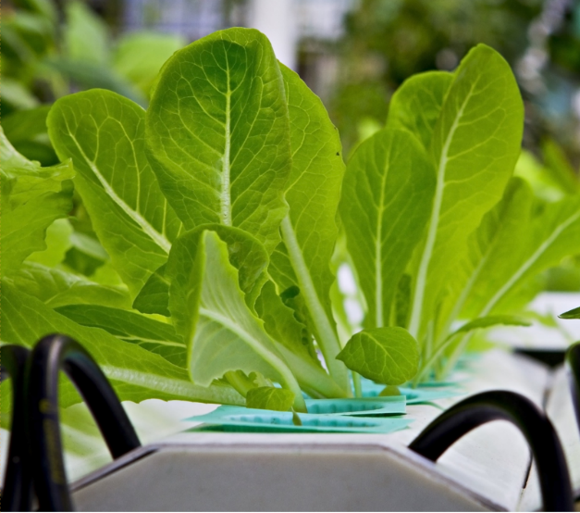
Photos
Image file .jpg
Image resolution
At least 150 dpi, not more than 300 dpi
Zoom in to 100%, this is how your image will look when printed.

